Slide 1
Optimizing 360° Video Streaming based Texture Tile Division
Xingming Zhang
Yudong Wen
Jiasheng Chen

Slide 2
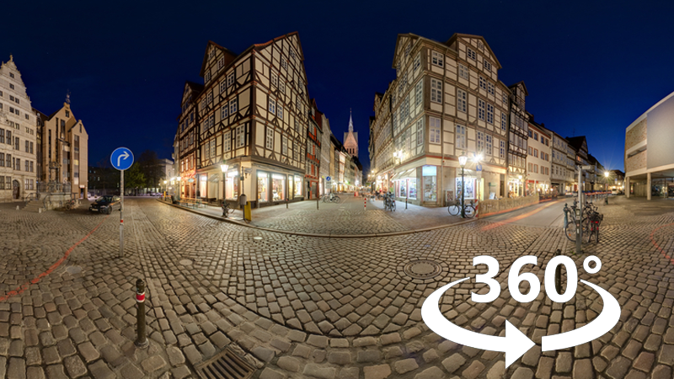
Background
Panoramic video
Hight resolution
High bit rate
Notes:
全景视频, 也就是360度视频, 是比较特殊的一种视频类型, 随着360摄影设备的发展和网速的提高, 全景视频慢慢走近人们的视野, 已经成为视频服务的新型载体
但是全景视频具有高分辨率, 高码率的特性, 这给全景视频的传输带来了巨大的挑战,
如何利用好已有的网络带宽, 给用户提供良好的视频观看体验, 也一直是热门的研究课题

Slide 3
Background
Common transmission schemes:
VIS(Viewport-independent Streaming)
ERP isometric projection coding is generally used, and the same coding and transmission with general videos.
Features:
1. High bandwidth requirements. Limited bandwidth resources require a long time of buffering.
2. Only part of the packets are played at the same time. Therefore, the bandwidth usage is low.
VDS(Viewport-dependent Streaming)
Create multiple video files based on multiple preset viewpoints for the same video.
Each video file uses high quality near the viewpoints (and low quality for other areas).
When the user's viewpoint changes during the viewing process, the client switches the video file accordingly.
Features:
1. Compared with the VIS solution, the bandwidth is reduced by 80%.
2. Compared with VIS copywriting, video file storage has increased by 6 times.

Slide 4
Background
How does the quality of each block be distributed?
Only transmit, decode the content included in viewport?
Reduce the rebuffering time?
(network environment, frame synchronization)
How do you merge the tiles?
TBS(Tile-based Streaming)
The panoramic video is divided into several rectangular tiles, and each tile corresponds to a specific area of the picture.
Select some tiles based on the viewpoint for transfer.
Features:
1. Different tiles have different bit rate allocation, and all tiles can be transmitted independently
Notes:
目前基于Tile的全景视频已经成为一种全景视频传输的主要趋势,
也就是将全景视频按照时间和空间切成很多的小块进行传输,
这其中涉及到很多挑战

Slide 5
Related Work
Flare
Using the viewport-adaptive method to get those tiles the user needs.
A QoE favoring high average block quality and penalizing block quality switching and blocking is designed to select the most suitable block quality in the search space of block quality.
Limitations: imperfect viewport prediction may cause stalls.
Pano
Considering user sensitivity and establishing a model to quantify sensitivity.
Divide the video into tiles according to user sensitivity.
The author assumes that there are historical tracks for the video and uses them to replace the user's viewpoint tracks.
The author uses MPC (existing algorithm) to estimate the network bandwidth, and maximize the overall video quality perception index under limited bandwidth.
Limitations: viewpoint was moving horizontal direction and at a constant speed.
Notes:
传统的全景视频传输都是将视频进行全传, 这样非常浪费带宽
Flare是第一篇提出只传输用户看到的那些视频块, 预测用户的视口, 然后传输特定画质的视频
Flare的主要问题就是如果视口预测不准确, 就会造成视频卡顿
Flare之后又有一篇研究, Pano, Pano是将用户的视觉敏感度纳入考虑
比如用户对快速移动的物体的敏感度较低, 对于凝视点的敏感度高, 其他的低
然后建立模型量化用户视觉敏感度, 然后也是将视频分块然后每个块可以编码不同的画质
Flare的主要问题是他们在模拟用户视点移动的时候, 视点的移动都是水平匀速移动的
由于这些方法都存在一些问题, 所以我们也提出了我们自己的一些想法

Slide 6
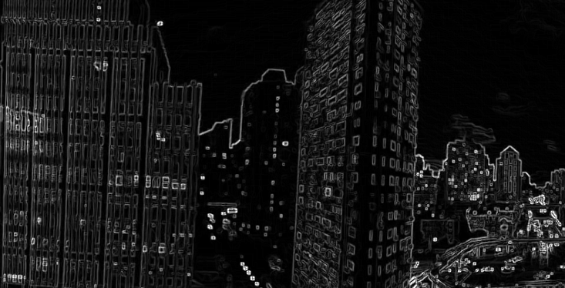
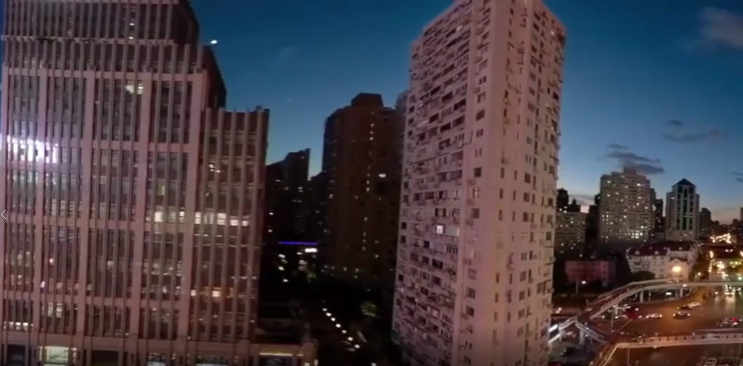
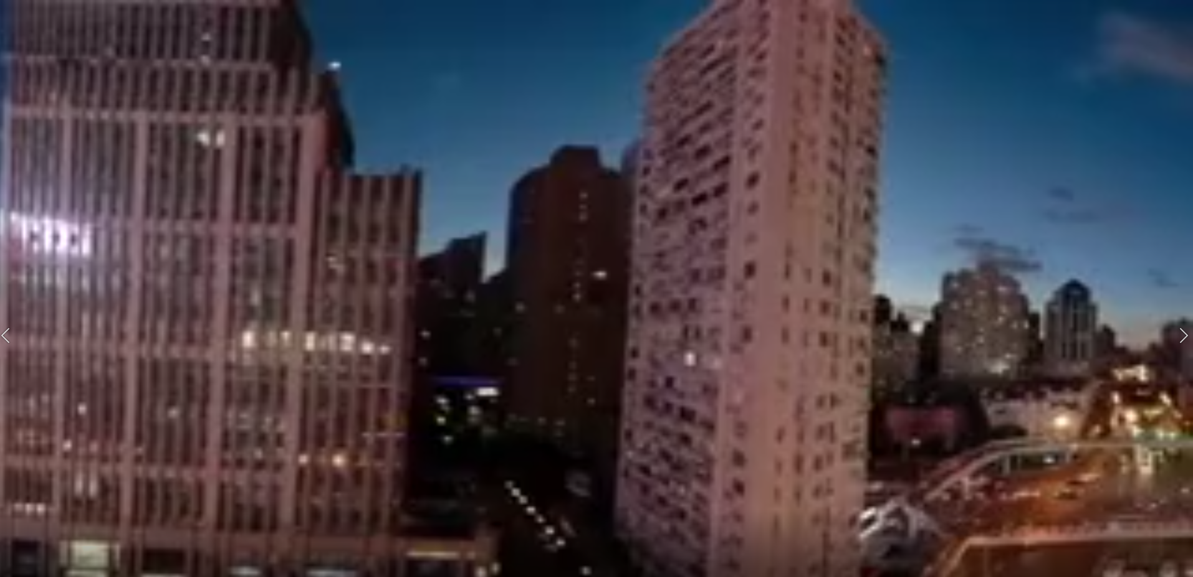
Our Approach
Prewitt gradient
1080P
360P
Combine: 1080P + 360P

Slide 7

Our Approach
Segment by texture complexity
Segment uniformly
Expected effect
Hard to implement
Inaccurate segment method
Easy to implement

Slide 8

Implementation
Manifest.json
Selector
52
32
18
L
L
L
67
55
48
Loader
L
D
D
D
L
L
L
D
D
D
Decoder
L
L
D
D
D
65
47
79
Complexity score of each tile
BG buffer
Tile buffer
BG 144P
360P
720P
1080P
Server
Client

Slide 9
Implementation
Choose chunk-quality based on textures.
Manifest.json
Selector
L
L
L
Loader
L
D
D
D
L
L
L
D
D
D
Decoder
L
L
Background-decoder run all time,
Tile-decoders run sometimes.
D
D
D
BG buffer
Tile buffer
Internet
Decode and render asynchronously.
Client

Slide 10
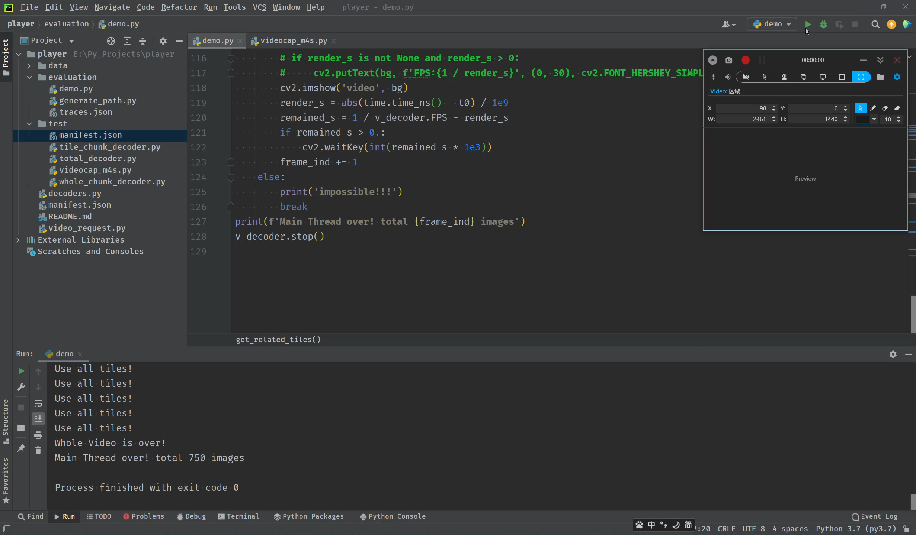
Evaluation

Slide 11
Evaluation
Baseline
Split the whole video into W*H tiles and t0-second chunks.
Request those tile-chunks included in 4*Viewport-Area.
Ours
Recode the original video into {360p, 480p, 720p, 1080p, 4k} and t0-second chunks.
Split the whole {480p, 720p, 1080p, 4k} video into W*H tiles and t0-second chunks.
Experiments
Total re-buffer time, Average bandwidth when playing video and PSPNR of the tiles around viewpoint compared with Baseline.
Influence of different tiling schema and chunk-quality-choice schema

Slide 12
Thanks
Xingming Zhang
Yudong Wen
Jiasheng Chen

